Slide 1
Covario Team Mid-Term Presentation
Covario x Cornell CFEM

Slide 2
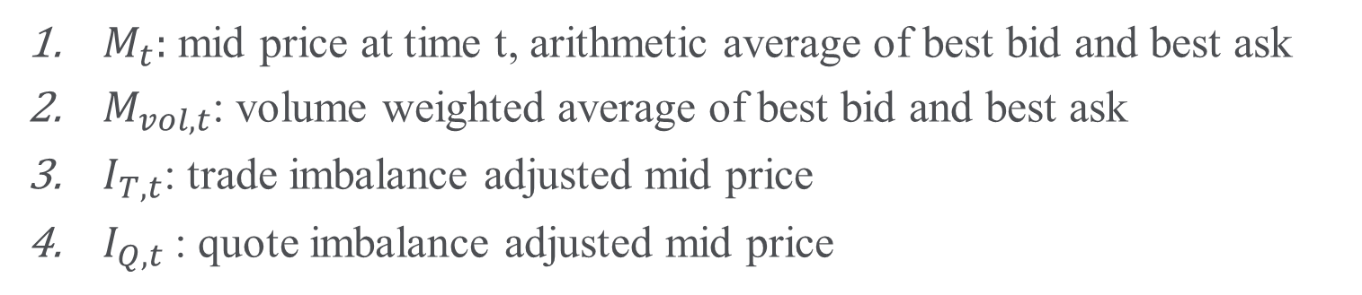
Definitions of fair price $F_{t}$
$M_{t}:$ mid price at time t, arithmetic average of best bid and best ask
$M_{vol,t}$: volume weighted average of best bid and best ask
$I_{T,t}$: trade imbalance adjusted mid price
$I_{Q,t}$: quote imbalance adjusted mid price

Slide 3
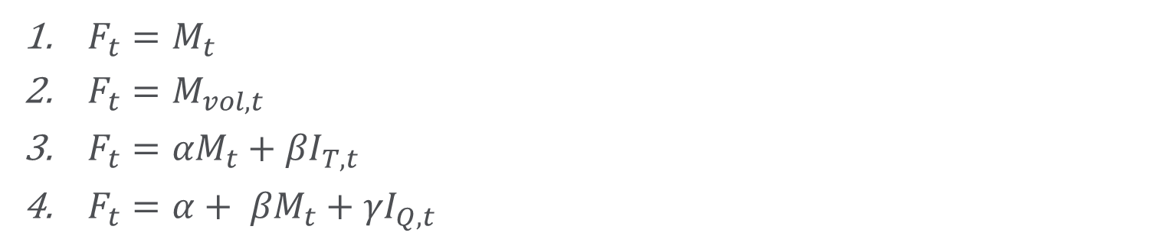
$$Definitions of Fair Price (F_{t})$$
${F_{t}=M}_{t}$
${F_{t}=M}_{vol,t}$
${{F_{t}=αM}_{t}+βI}_{T,t}$
${{F_{t}=α+ βM}_{t}+γI}_{Q,t}$

Slide 4
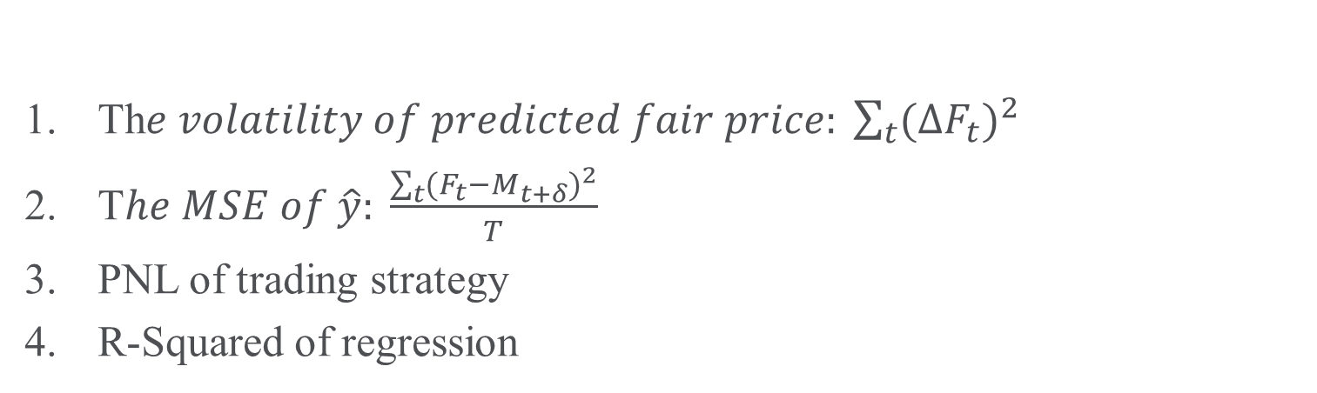
Model Comparison Metrics
Th$e volatility of predicted fair price: \sum_{t}{{(∆F_{t})}^{2}}$
T$he MSE of \hat{y}: \frac{\sum_{t}{{(F_{t}−M_{t+δ})}^{2}}}{T}$
PNL of trading strategy
R-Squared of regression

Slide 5
Procedure
Look ahead windows: 1, 5, 15, 30, 60 seconds
Training set: July 1-19
Test set: July 20, 25, 30
Test all definitions on our four metrics for each look ahead window

Slide 6
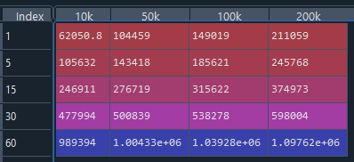
Volume Weighted Mid Price SE

Slide 7
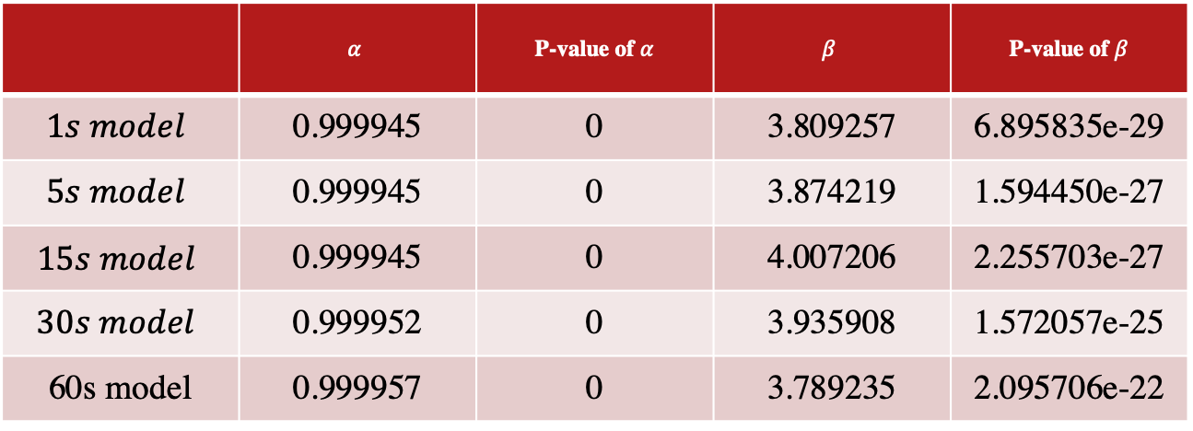
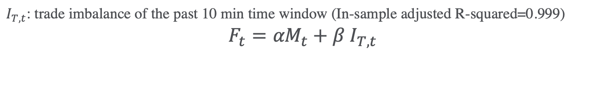
Trade Imbalance Price
$I_{T,t}$: trade imbalance of the past 10 min time window (In-sample adjusted R-squared=0.999)
$${{F_{t}=αM}_{t}+β I}_{T,t}$$
 | $$α$$ | P-value of $α$ | $$β$$ | P-value of $β$
$$1s model$$ | 0.999945 | 0 | 3.809257 | 6.895835e-29
$$5s model$$ | 0.999945 | 0 | 3.874219 | 1.594450e-27
$$15s model$$ | 0.999945 | 0 | 4.007206 | 2.255703e-27
$$30s model$$ | 0.999952 | 0 | 3.935908 | 1.572057e-25
60s model | 0.999957 | 0 | 3.789235 | 2.095706e-22

Slide 8
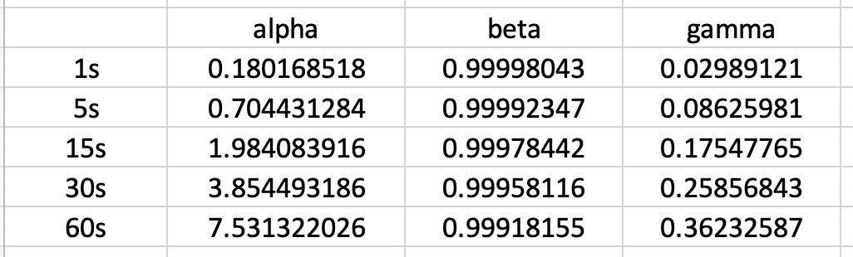

Quote Imbalance Price
$I_{Q,t}$: quote imbalance of a past time period

Slide 9
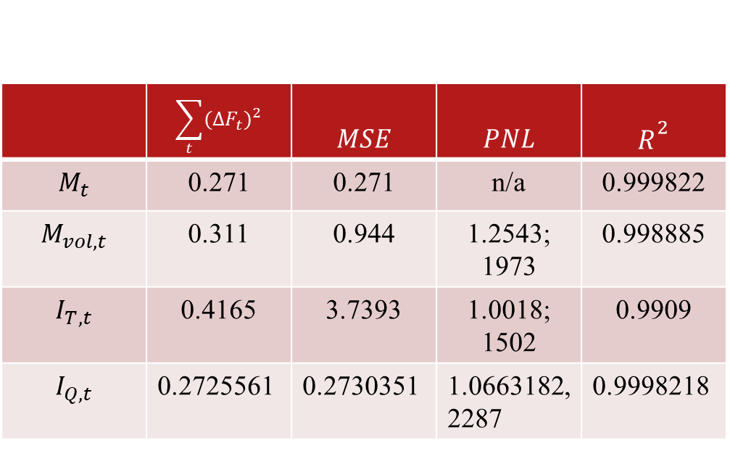
1 Second Window
 | $$\sum_{t}{{(∆F_{t})}^{2}}$$ | $$MSE$$ | $$PNL$$ | $$R^{2}$$
$$M_{t}$$ | 0.271 | 0.271 | n/a | 0.999822
$$M_{vol, t}$$ | 0.311 | 0.944 | 1.2543; 1973 | 0.998885
$$I_{T,t}$$ | 0.4165 | 3.7393 | 1.0018; 1502 | 0.9909
$$I_{Q,t}$$ | 0.2725561 | 0.2730351 | 1.0663182,2287 | 0.9998218

Slide 10
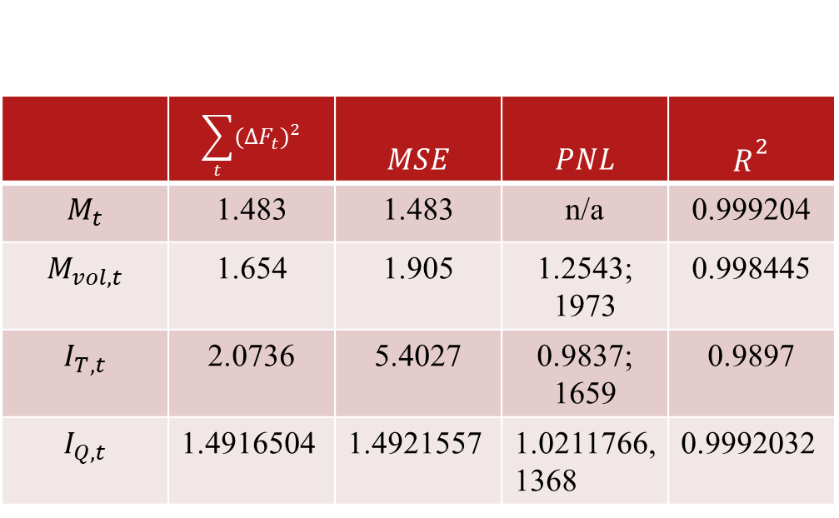
5 Second Window
 | $$\sum_{t}{{(∆F_{t})}^{2}}$$ | $$MSE$$ | $$PNL$$ | $$R^{2}$$
$$M_{t}$$ | 1.483 | 1.483 | n/a | 0.999204
$$M_{vol, t}$$ | 1.654 | 1.905 | 1.2543; 1973 | 0.998445
$$I_{T,t}$$ | 2.0736 | 5.4027 | 0.9837; 1659 | 0.9897
$$I_{Q,t}$$ | 1.4916504 | 1.4921557 | 1.0211766,1368 | 0.9992032

Slide 11
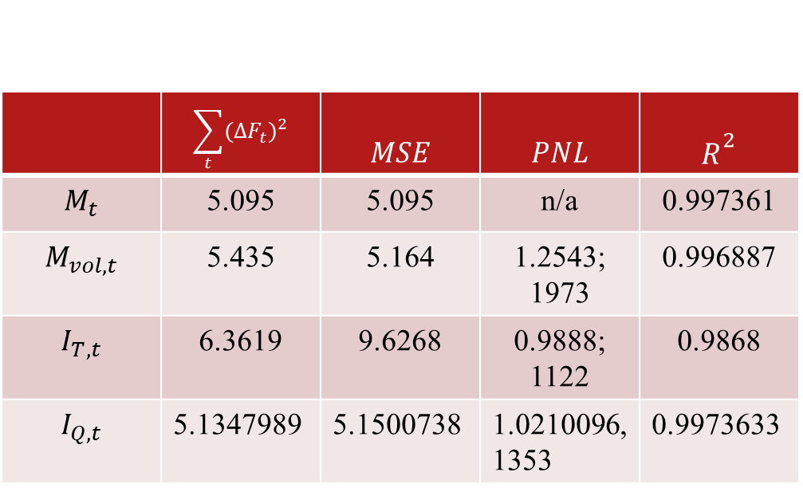
15 Second Window
 | $$\sum_{t}{{(∆F_{t})}^{2}}$$ | $$MSE$$ | $$PNL$$ | $$R^{2}$$
$$M_{t}$$ | 5.095 | 5.095 | n/a | 0.997361
$$M_{vol, t}$$ | 5.435 | 5.164 | 1.2543; 1973 | 0.996887
$$I_{T,t}$$ | 6.3619 | 9.6268 | 0.9888; 1122 | 0.9868
$$I_{Q,t}$$ | 5.1347989 | 5.1500738 | 1.0210096, 1353 | 0.9973633

Slide 12
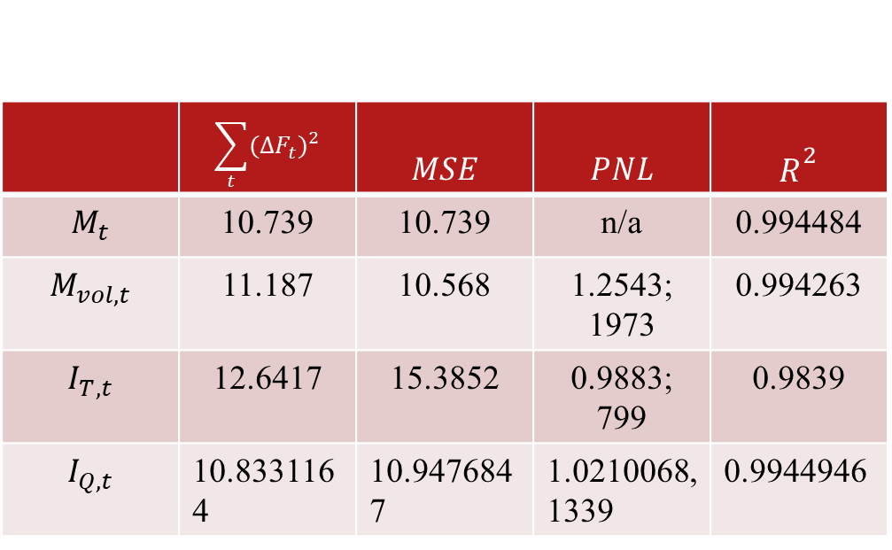
30 Second Window
 | $$\sum_{t}{{(∆F_{t})}^{2}}$$ | $$MSE$$ | $$PNL$$ | $$R^{2}$$
$$M_{t}$$ | 10.739 | 10.739 | n/a | 0.994484
$$M_{vol, t}$$ | 11.187 | 10.568 | 1.2543; 1973 | 0.994263
$$I_{T,t}$$ | 12.6417 | 15.3852 | 0.9883; 799 | 0.9839
$$I_{Q,t}$$ | 10.8331164 | 10.9476847 | 1.0210068,1339 | 0.9944946

Slide 13
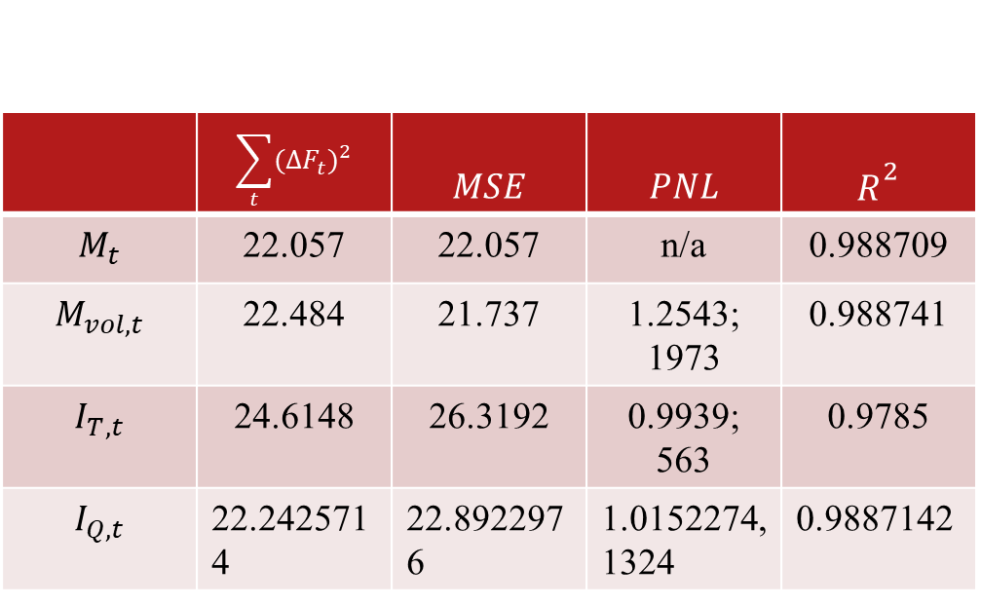
60 Second Window
 | $$\sum_{t}{{(∆F_{t})}^{2}}$$ | $$MSE$$ | $$PNL$$ | $$R^{2}$$
$$M_{t}$$ | 22.057 | 22.057 | n/a | 0.988709
$$M_{vol, t}$$ | 22.484 | 21.737 | 1.2543; 1973 | 0.988741
$$I_{T,t}$$ | 24.6148 | 26.3192 | 0.9939; 563 | 0.9785
$$I_{Q,t}$$ | 22.2425714 | 22.8922976 | 1.0152274,1324 | 0.9887142

Slide 14
Future Work

